Slide 1
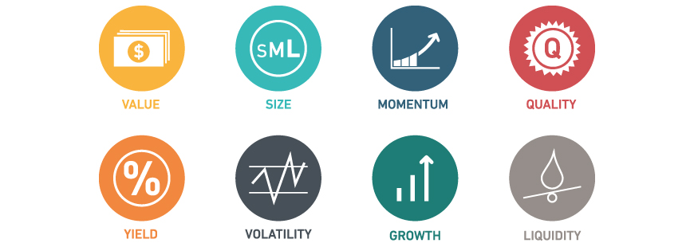
Factor Investing
Quant Team

Slide 2



Roadmap to Alpha
Factor Timing: Business Cycle, Factor Momentum
Factors: Momentum, Low Vol, BAB, Value...
History/Theory of Factor Investing
Notes:
M

Slide 3
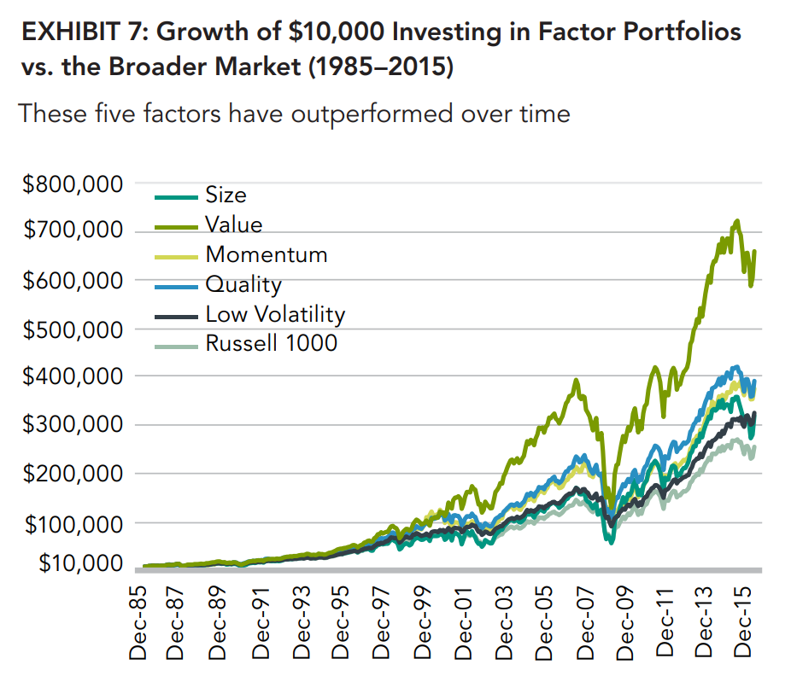
Motivation for Factor Investing
Source: Fidelity - An Overview of Factor Investing (2016)
Notes:
We will show you how to invest in these factors
M

Slide 4
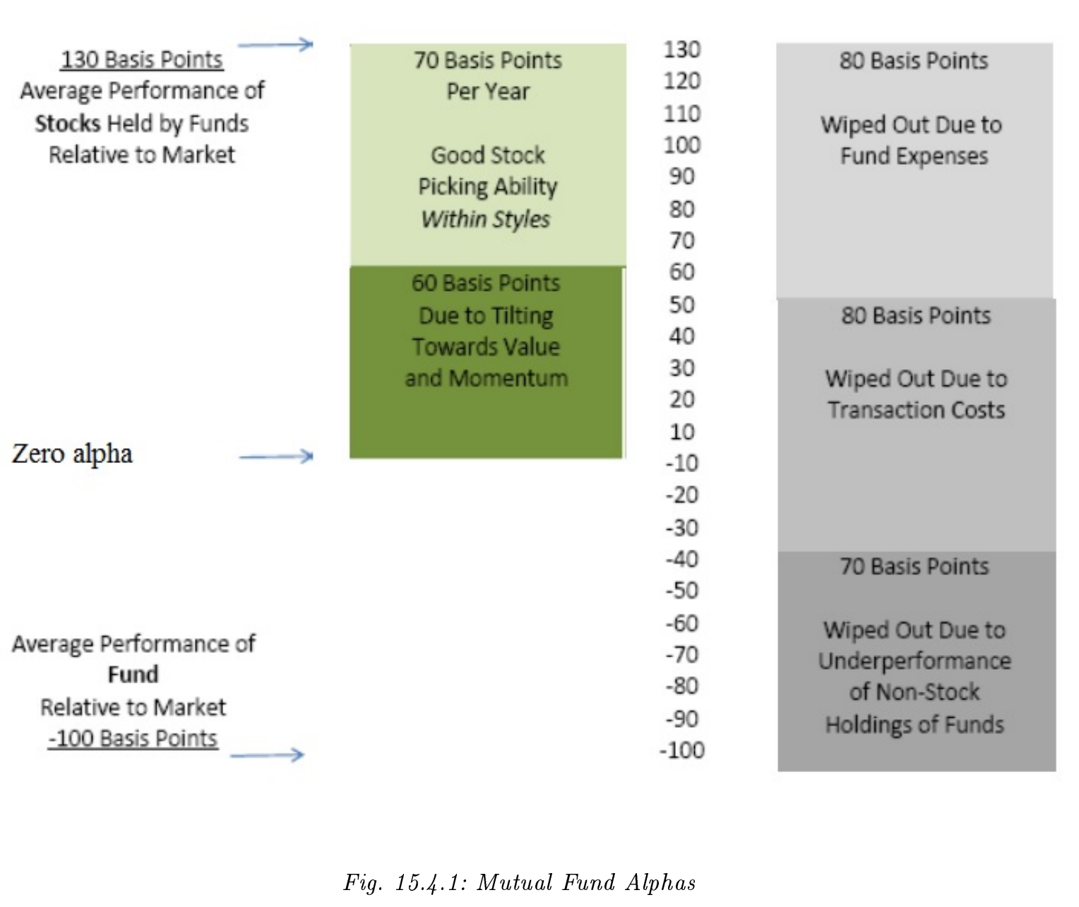
Mutual Funds Profit through Factors
Notes:
-Mutual funds make their money through tilting to factors
B

Slide 5
Arbitrage Pricing Theory (APT)
Given the set of systematic factors associated with security returns in the economy, the APT tells us that we can always model expected security returns (discount rates) using some kind of linear factor model
When thinking of factors, think MKT (market), SMB (size), HML (value), etc.
Notes:
M

Slide 6


Factor Model (APT)
HML
With i securities and k factors
MKT
SMB
Notes:
M

Slide 7
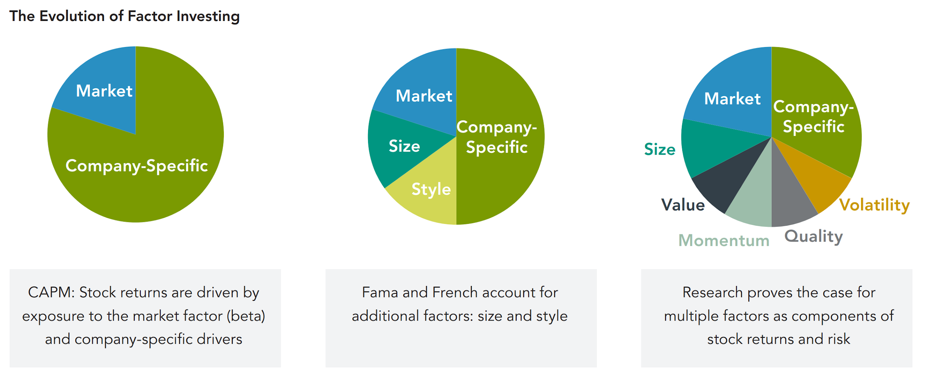
History of Factor Investing
Notes:
1960s, 1992, 2014
M

Slide 8
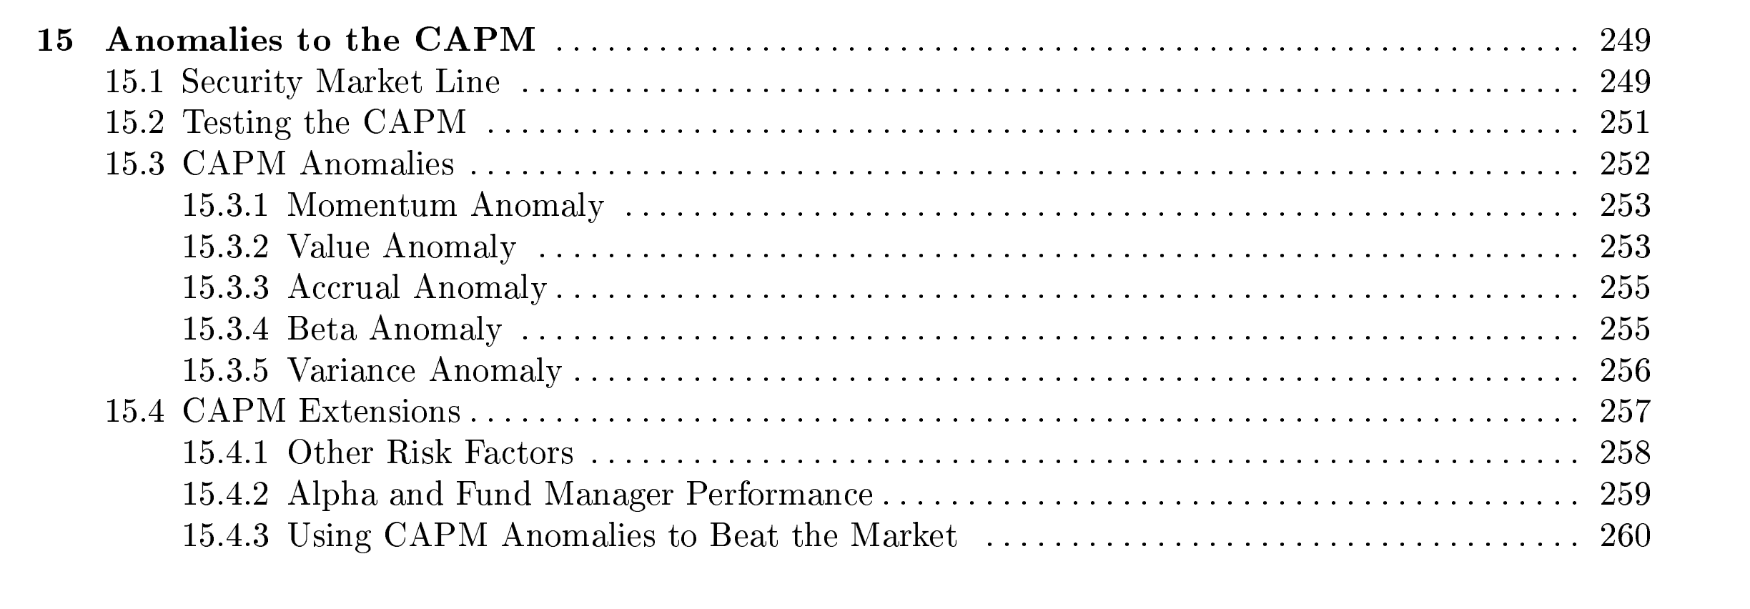
CAPM Anomalies - Ch. 15 (Bates/Boyer)
Notes:
M

Slide 9

“Relative Strength” (cross-sectional)
UMD = Up minus Down
WML = Winners minus Losers
Momentum: Past returns excluding most recent month
Momentum Factor: avg return of TOP 30% of stocks minus avg return of bottom 30%
Notes:
B

Slide 10
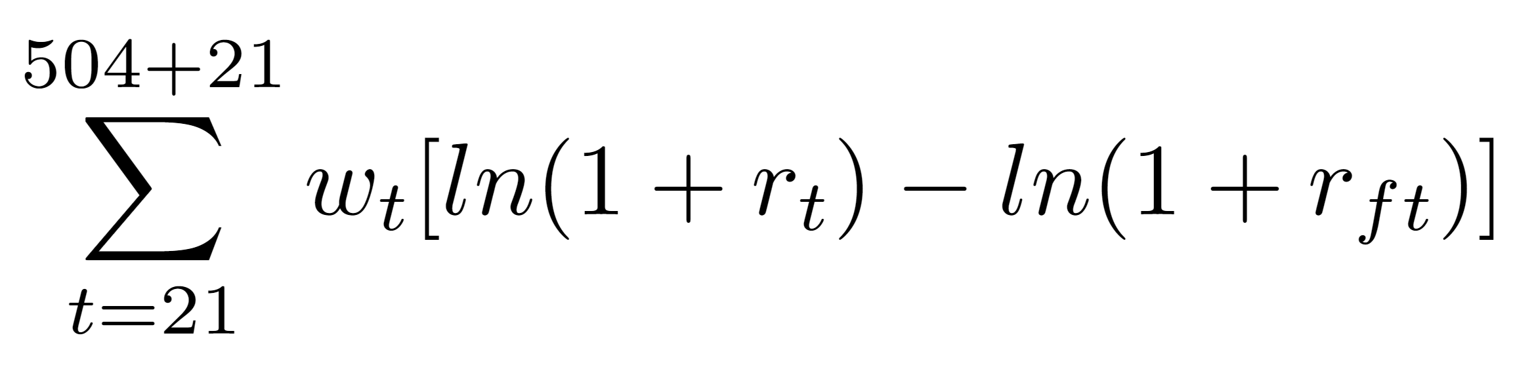
Momentum of a Stock
Two years prior
Stock Returns
Excluding most recent month
Exponential weight
Risk-free rate
Notes:
Half-life is 126 days
B

Slide 11
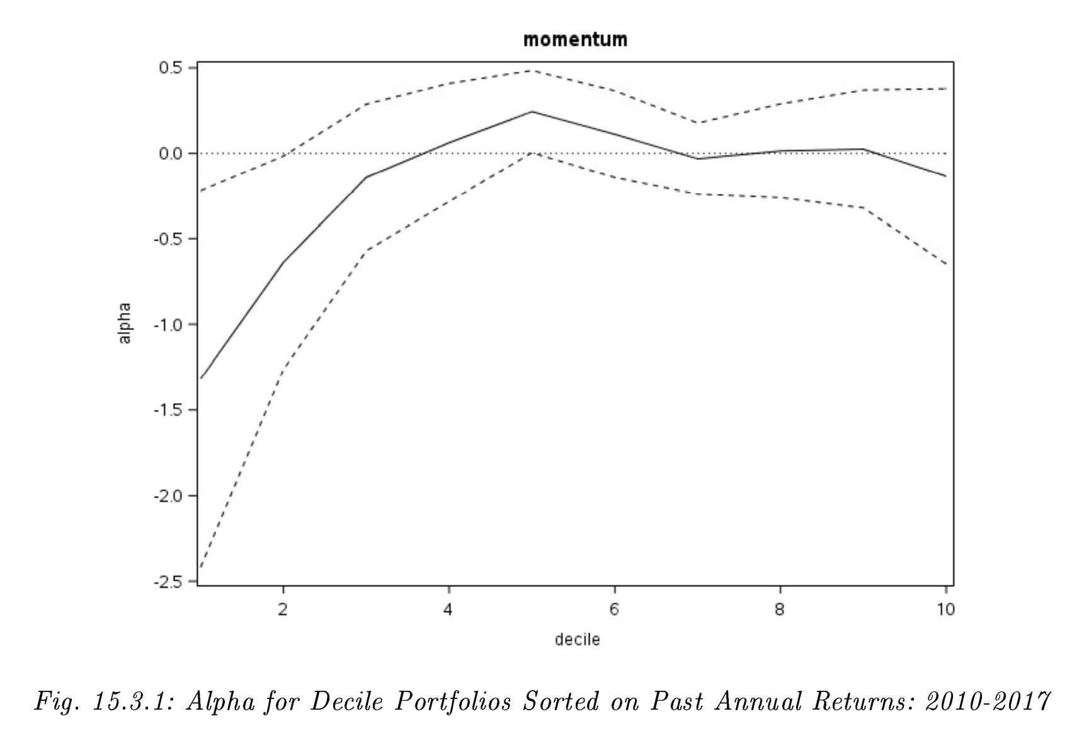
Momentum Portfolios (Post-FC)
Winners
Losers
Notes:
Past losers still lose
Dotted lines are confidence intervals
B

Slide 12
Momentum Factor is Robust
Persistent across time
Pervasive globally - stocks, bonds, commodities, currencies
Robust to various definitions
Survives transaction costs
Behavioral Explanation: investor overreaction
Notes:
B

Slide 13

Low Vol and Betting Against Beta (BAB)
CAPM predicts HIGH beta ⇒ HIGH return
BUT…
LOW volatility and LOW beta stocks have done better historically
Notes:
E

Slide 14
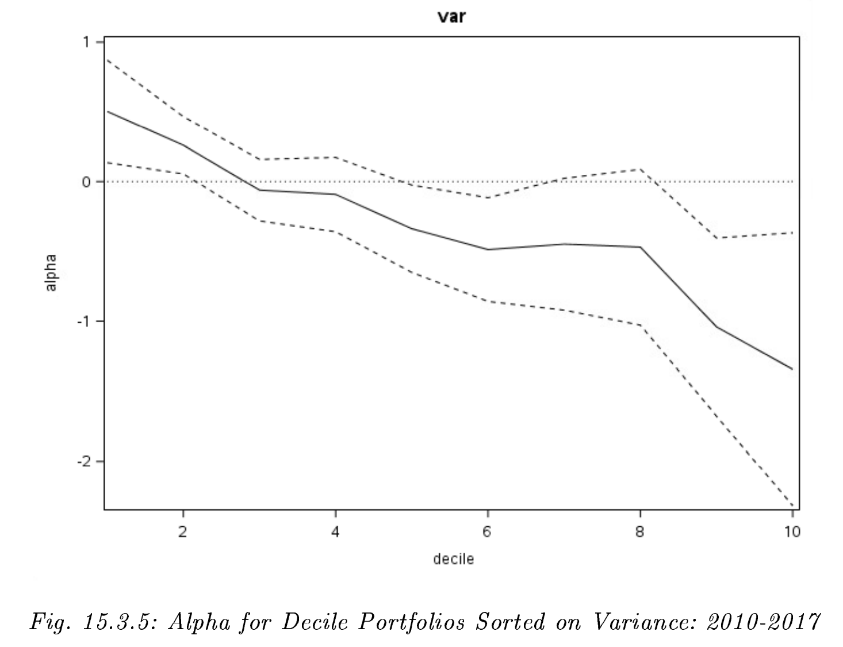
Low Vol Portfolios
Low Vol Stocks
High Vol Stocks
Notes:
E - low volatility

Slide 15
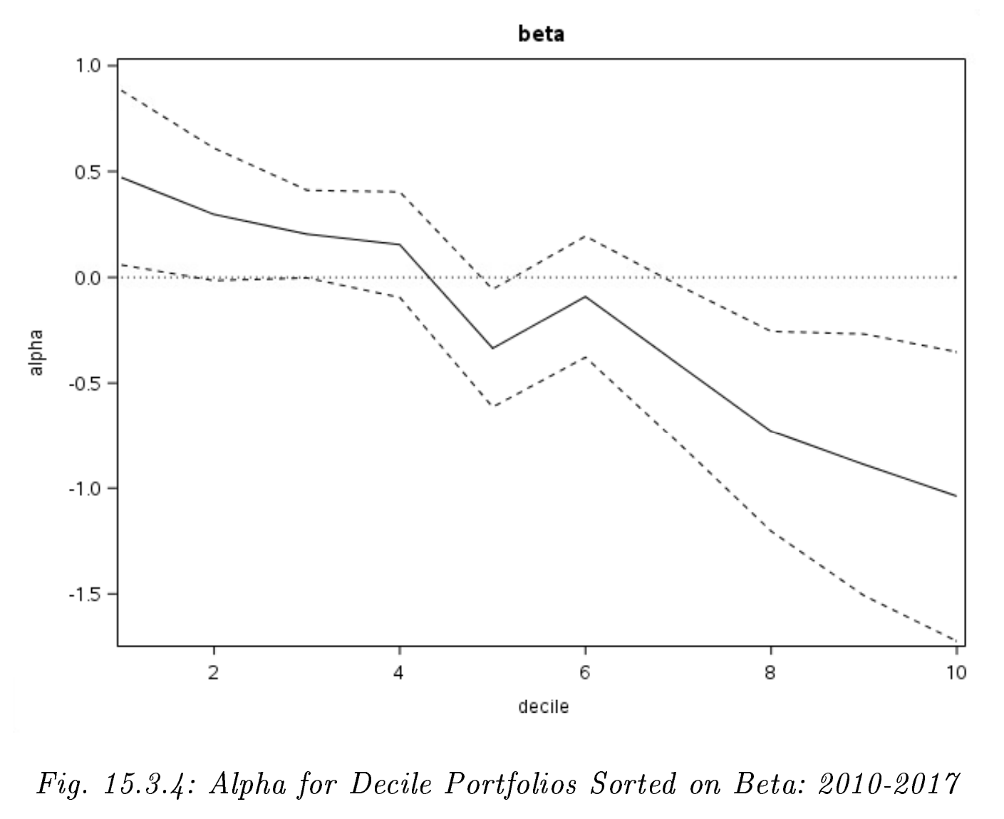
BAB portfolios
High
Beta
Stocks
Low Beta Stocks
Notes:
E

Slide 16
Can we “time” beta?
FED announcements
Macro signals
Notes:
E/B

Slide 17
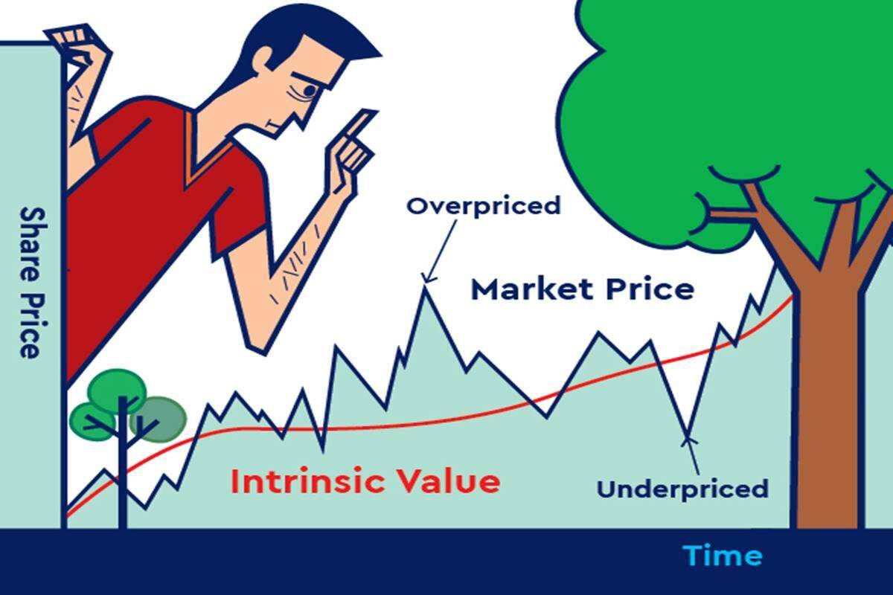
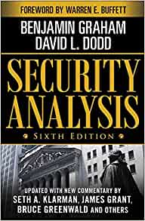
Value Factor
HML - High minus Low
Notes:
B

Slide 18
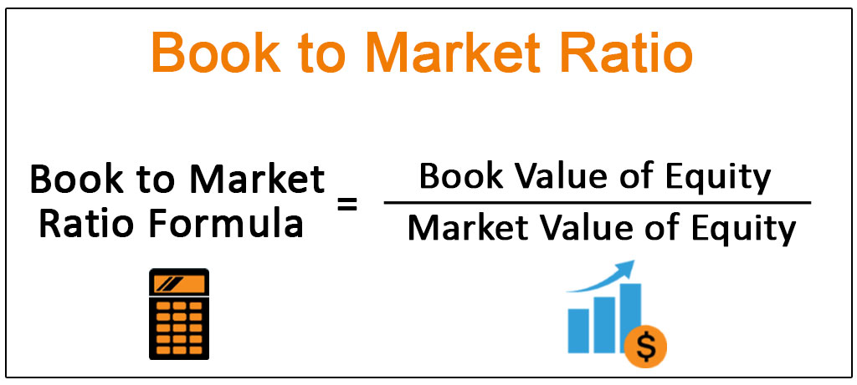
High B/M ⇒ Value Stock
Low B/M ⇒ Growth Stock
Notes:
B

Slide 19
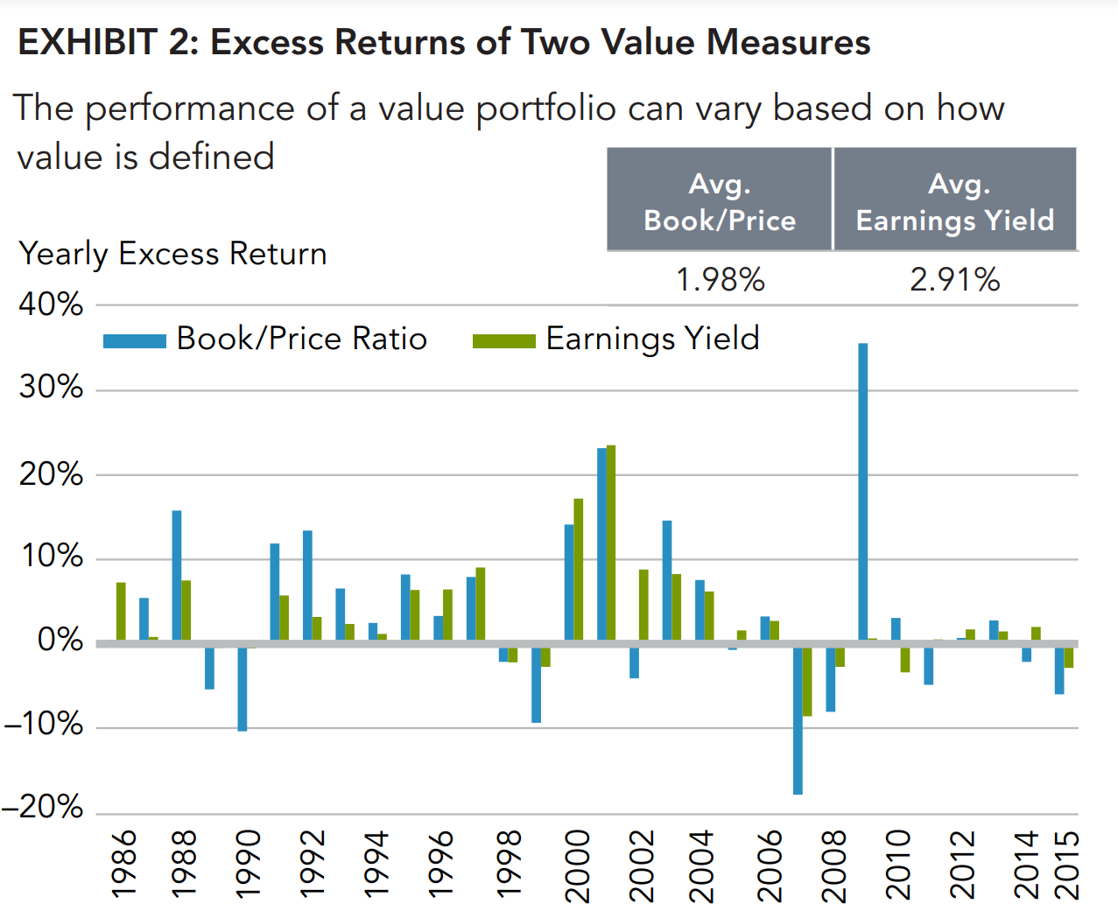
Value Factor Historical Payoff
Fama & French
publish seminal work
Notes:
B

Slide 20
Value Factor Explanations
Behavioral explanation: undervalue boring stocks, overvalue flashy stocks
Rational explanation: value stocks riskier
Market deem value stocks to be “relatively distressed”
Notes:
B

Slide 21
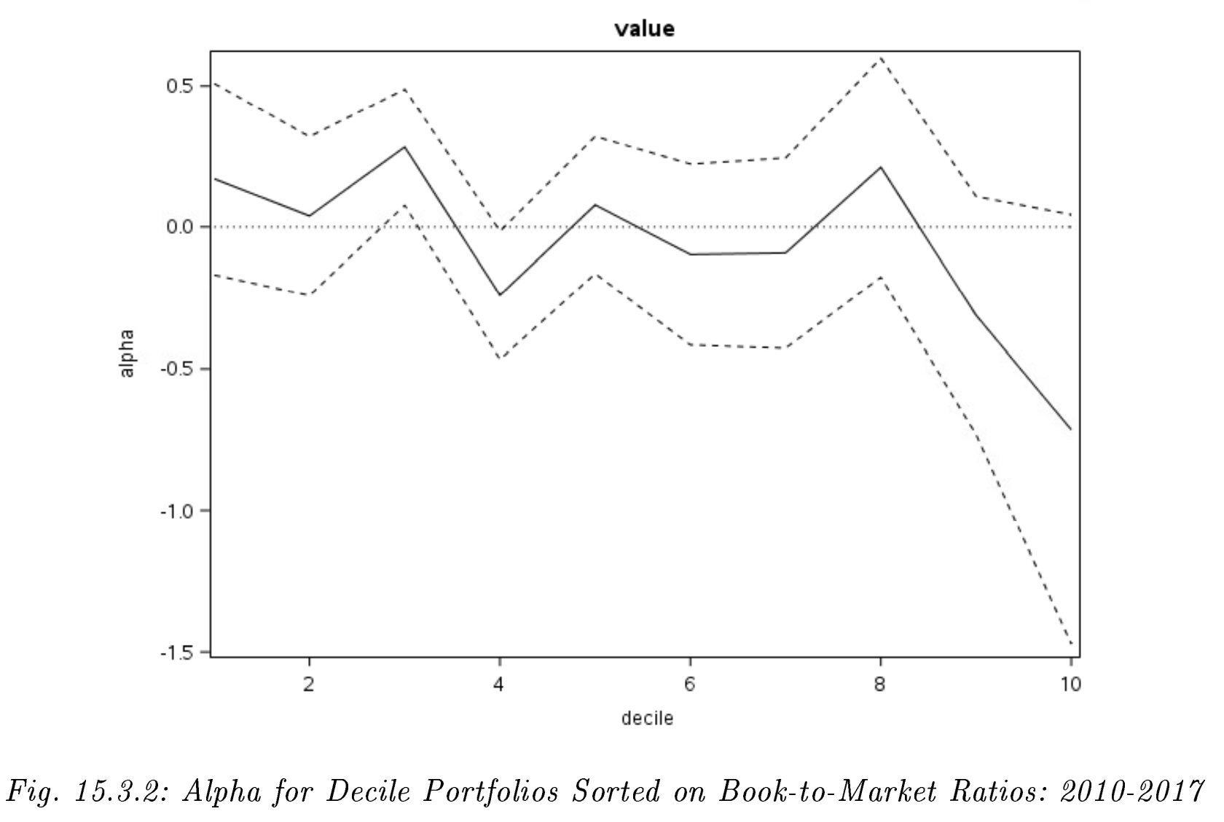
Recent Failure in Value Factor
Growth Stocks
Value Stocks
Notes:
B

Slide 22
Is the “value factor” dead or do we need better timing?
Notes:
B

Slide 23
Factor timing is…
nuanced.
Notes:
E

Slide 24
Challenges:
Time-varying properties of factor premia
Data-mining
Data revisions
Correlation pitfall
And many more...
Notes:
E (all)

Slide 25
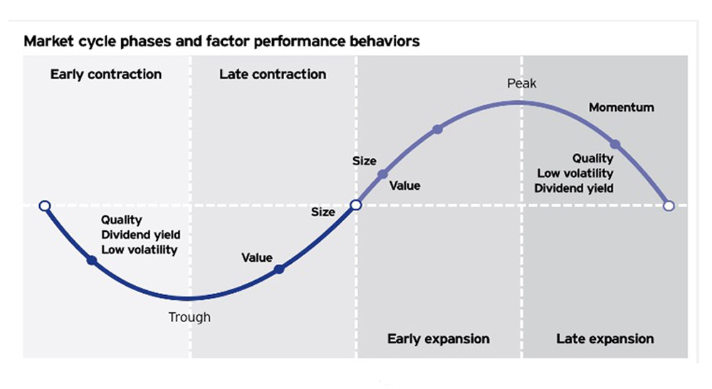
Factor Timing Strategies to Explore:
Business Cycle
Factor Momentum
Notes:
E

Slide 26
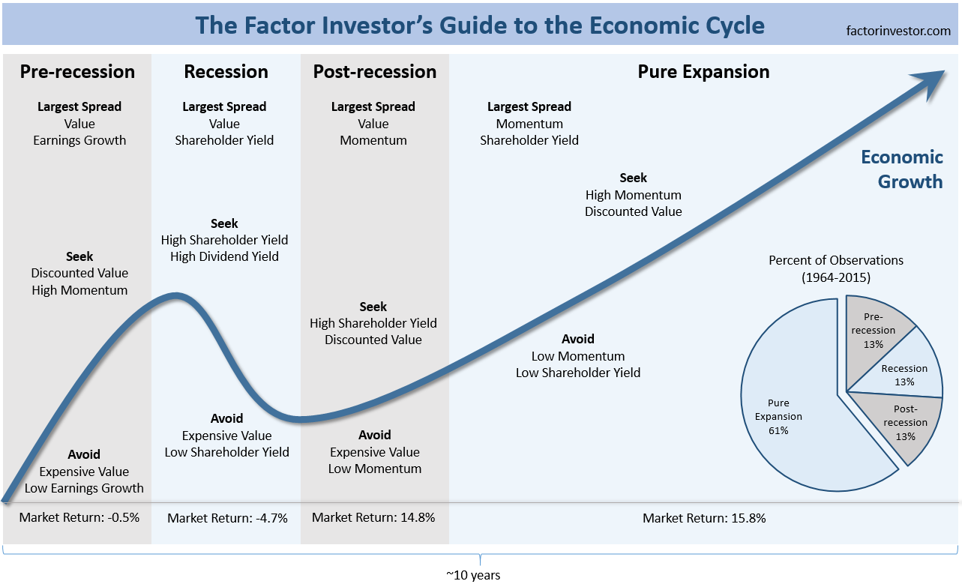
Business/ Economic Cycle
Notes:
Peter Lynch famously said, "If you spend more than 13 minutes analyzing economic and market forecasts, you've wasted 10 minutes.” Lynch is the legendary former manager of the Magellan Fund at the major investment brokerage Fidelity.
The challenge with economic data is that it is notoriously prone to revisions, significant lags, and adjustments in how it is measured through time—all of which are not suitable for timely and reliable investment signals.

Slide 27
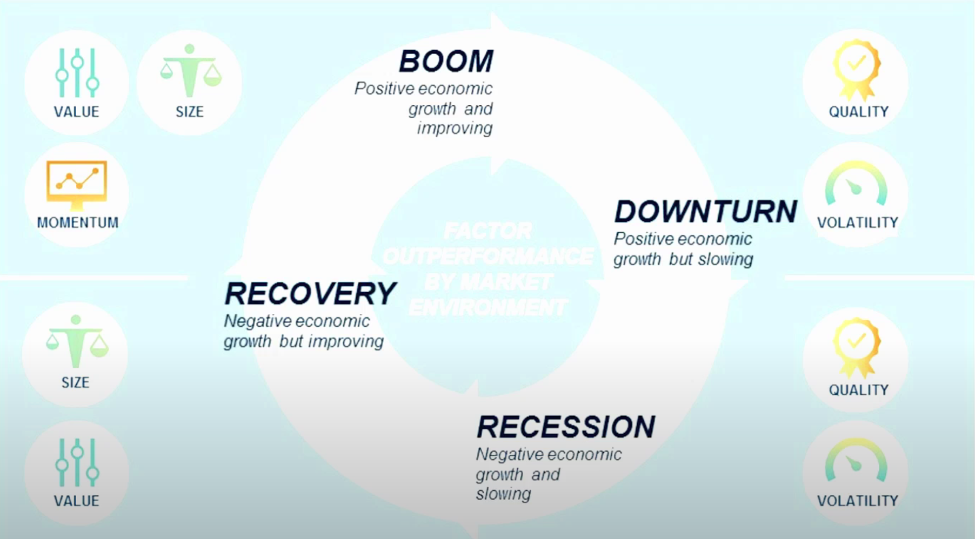
Notes:
M

Slide 28
Factor Momentum
Similar idea to stock momentum, but it is unique.
Factor momentum is pervasive across time and factors.
We’ll test for different predictive horizons and evaluation windows
Notes:
When stock momentum crashed at the onset of market recovery in 2009, factor momentum generated sudden and outsized proﬁts. It’s unique.
Similar to industry momentum, factor momentum is at its strongest with one-month formation and holding periods. However, as a test of robustness, the authors examined 36 strategies that use formation and holding periods ranging from one to six months. Each strategy’s Fama-French (2015) ﬁve-factor model alpha is statistically signiﬁcant with a t-value of at least 3.25.
E

Slide 29
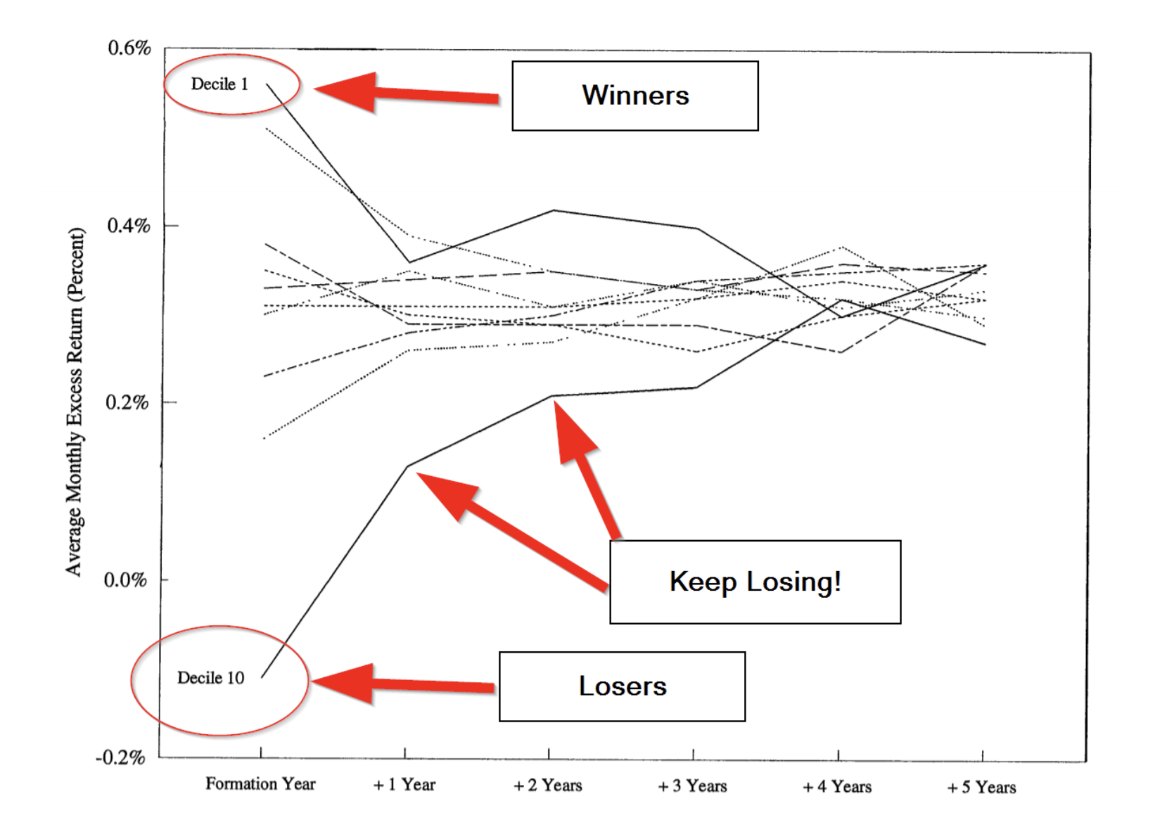
Notes:
E

Slide 30
References
Bates & Boyer. “Fundamentals of Investments” (2020)
Liu, Menchero, Orr, Wang. “The Barra US Equity Model (USE4): Empirical Notes” (2011).
http://cslt.riit.tsinghua.edu.cn/mediawiki/images/4/47/MSCI-USE4-201109.pdf?fbclid=IwAR3PDga2UDcYF9tcHkP2b439obidTu0akOxXgDK7KN6m1NsJk7s5vhcw0Zc
An Overview of Factor Investing (2016) https://www.fidelity.com/bin-public/060_www_fidelity_com/documents/fidelity/fidelity-overview-of-factor-investing.pdf
Notes:
Momentum Everywhere, Including in Factors https://alphaarchitect.com/2018/03/22/momentum-everywhere-including-factors/

Slide 31
Behavioral Explanations (low vol/BAB)
Leverage & shorting constraints
Investors/mutual fund managers seek high targets via high-beta stocks
Risk-loving investors
“Taste” for lottery-like investments means paying a premium to gamble

Slide 32
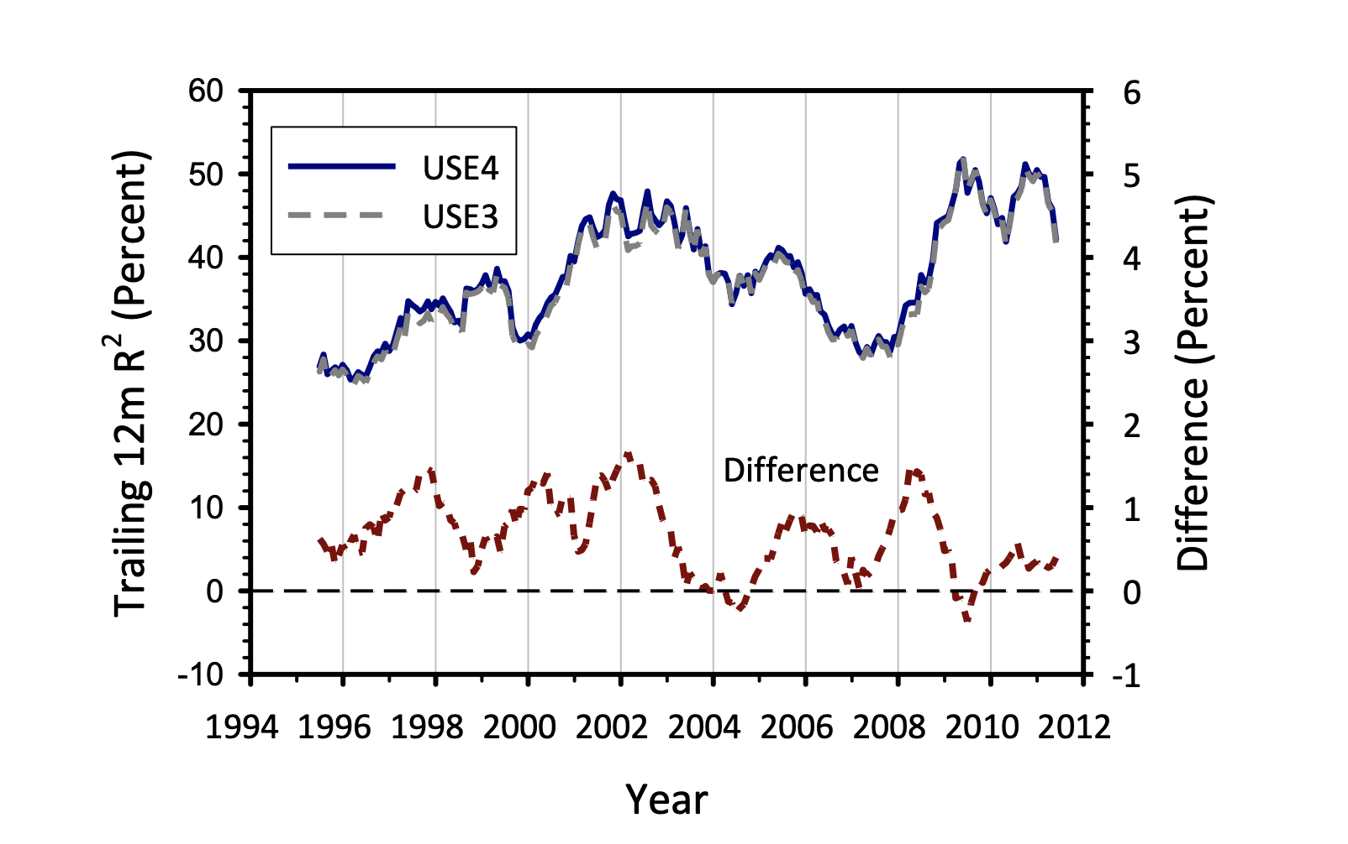
Explanatory Power
How good is our model, really?

